Slide 1
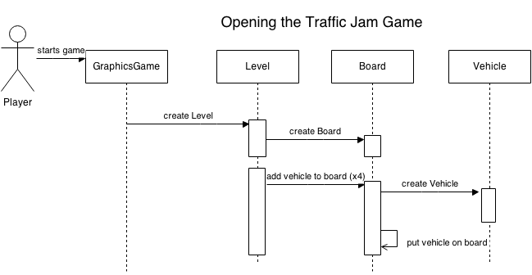
Sequence diagrams

Slide 2
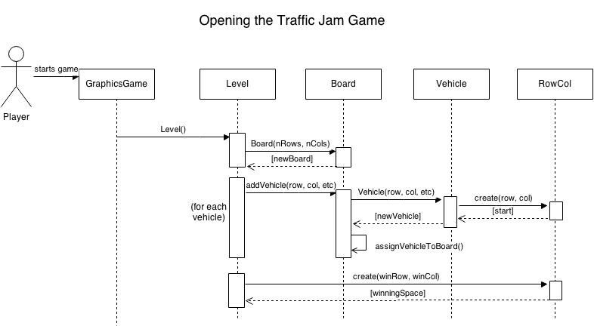
Sequence diagrams

Slide 3
boolean matches(InstruSpec otherSpec){ Set<String> keys = otherSpec.getProperties().keySet(); for(String property:keys) { if(!otherSpec.get(property).equals( mySpec.getProperty(property))){ return false; } } return true; }
Notes:
HashMap, same as before.

